Slide 1

Interactive Service Hub
DYNAMICS CRM 2016

Slide 2

Mitch Milam
Dynamics CRM Architect
Independent consultant and trainer
Ten-Time Dynamics CRM MVP
mitch@xrmcoaches.com
infinite–x.net
@mitchmilam

Slide 3
Future Events
Dynamics CRM Developer Bootcamp
Monday, June 6st – Friday, June 10th
http://tinyurl.com/JuneCrmBootcamp
Webinar: JavaScript and .NET Code upgrade best practices
Friday, May 27th 10:00 AM - 11:00 AM CDT
http://www.xrmcoaches.com/webinars
June webinars will be 17th and 24th

Slide 4
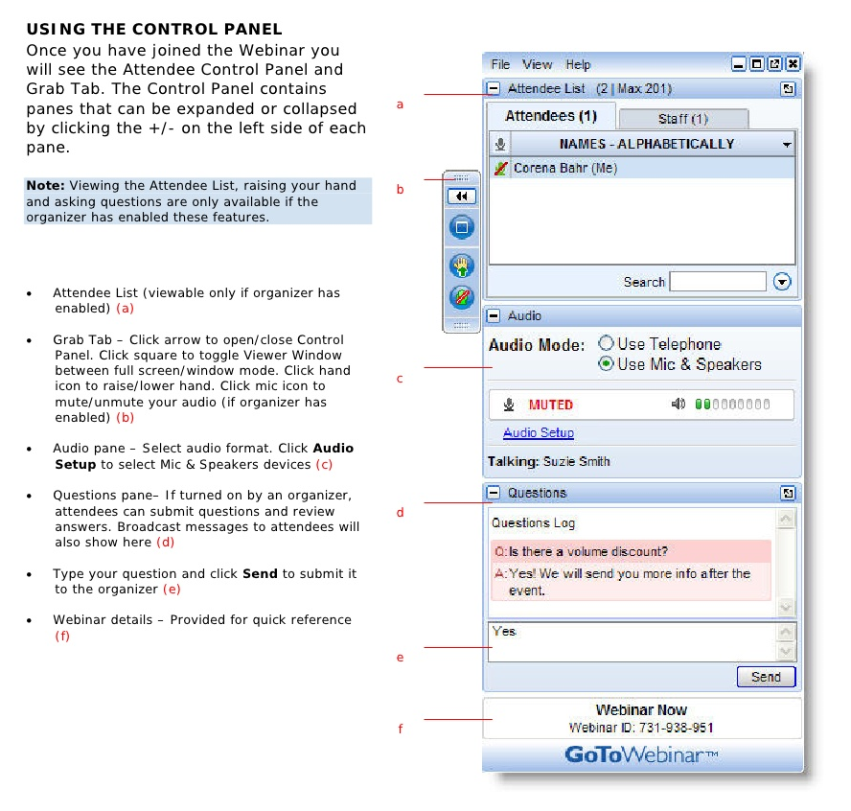
Webinar Housekeeping

Slide 5



2016 Training Roadmap
Webinars
http://www.xrmcoaches.com/webinars
KnowledgeBits
http://www.xrmcoaches.com/knowledgebits
Learning Plans
http://www.xrmcoaches.com/freestuff
More Goodies
Practice tests
On–Demand video training
Instructor–led training
Books

Slide 6
Agenda
Overview
Tour of the new navigation
Functionality discussion
Configuration
Demonstration

Slide 7
Overview

Slide 8
Access
New URL (Pre-Dynamics CRM 2016 Update 1)
https://[organization].crm.dynamics.com/engagementhub.aspx

Slide 9
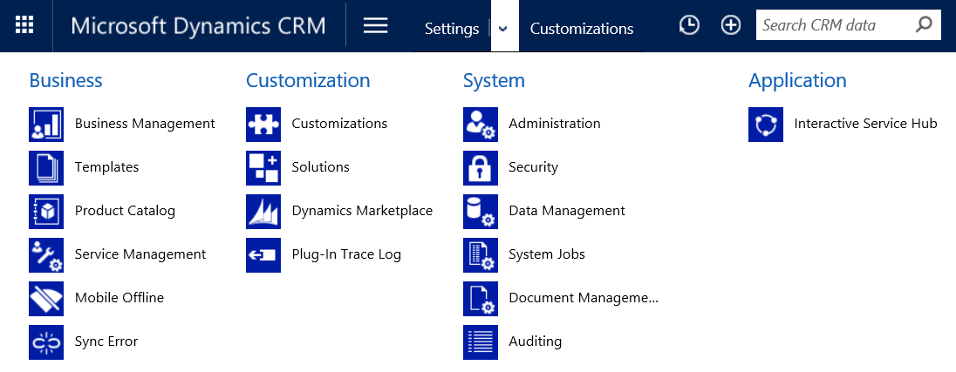
Access
Dynamics CRM 2016 Update 1

Slide 10
New Design
Uses Dynamics CRM mobile layout engine
Changes must be synchronized before use
Pages do not scroll, only sections

Slide 11
Navigation

Slide 12
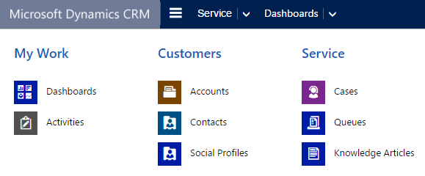
SiteMap

Slide 13
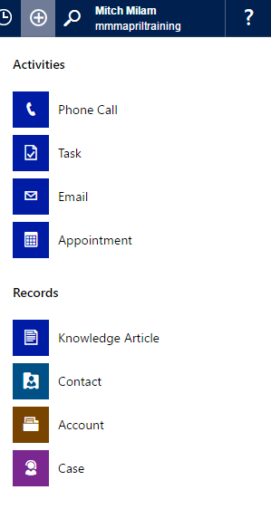
Quick Create

Slide 14
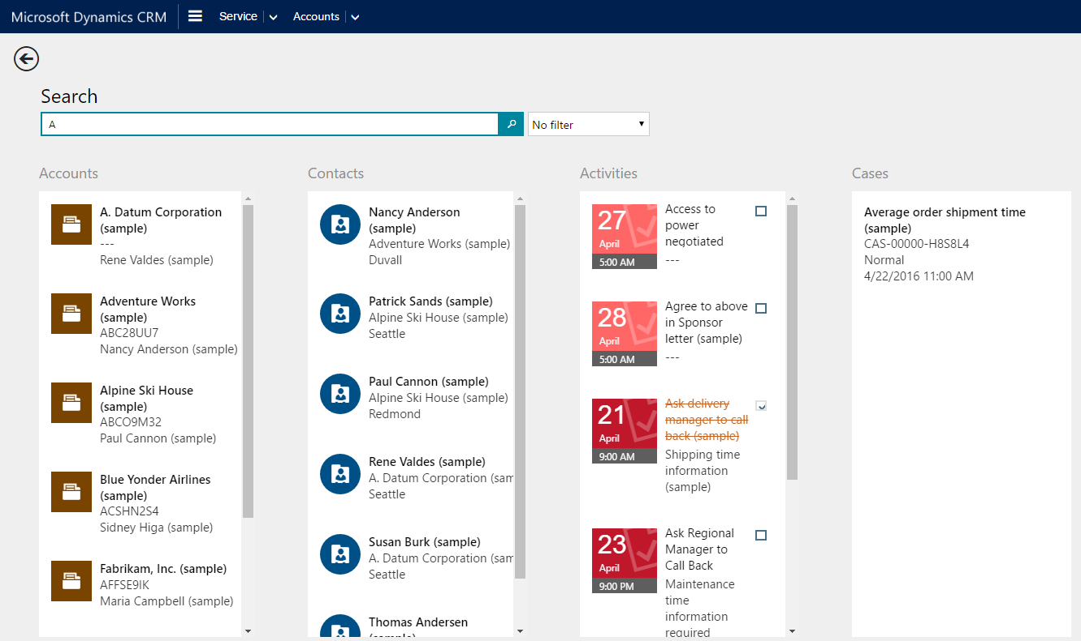
Searching

Slide 15
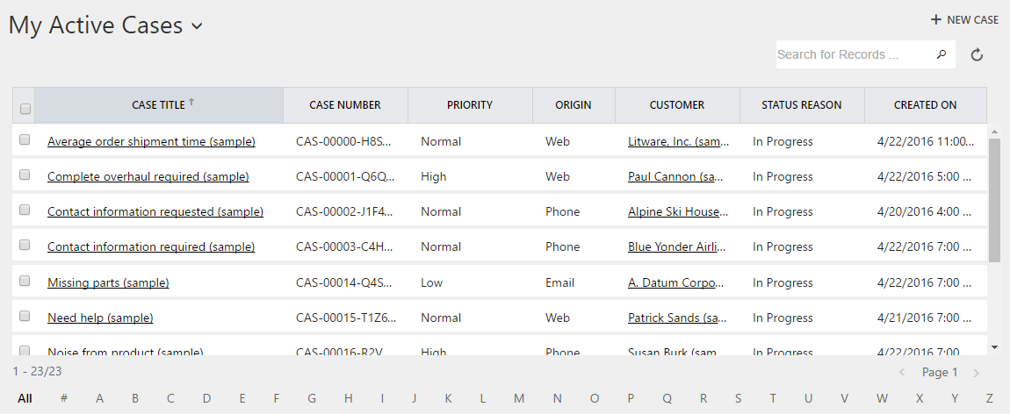
Views

Slide 16
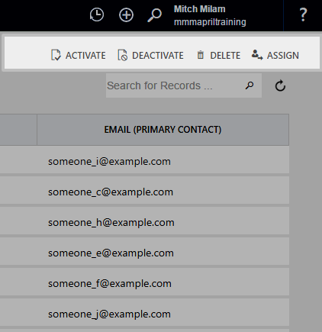
Command Bar

Slide 17
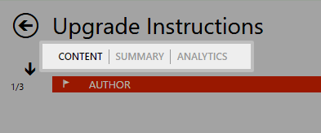
Horizontal Tabs

Slide 18
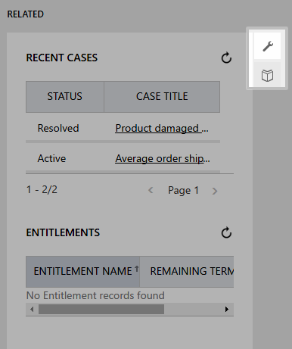
Vertical Tabs

Slide 19
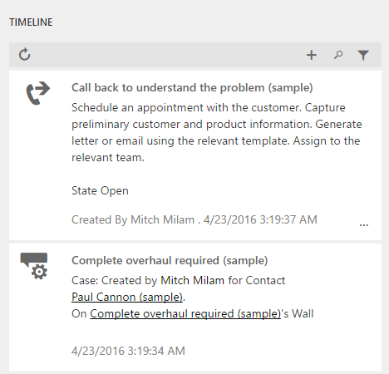
Interaction Wall (TimeLine)

Slide 20
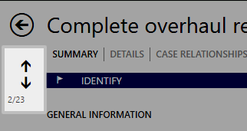
Record Navigation

Slide 21
Functionality

Slide 22
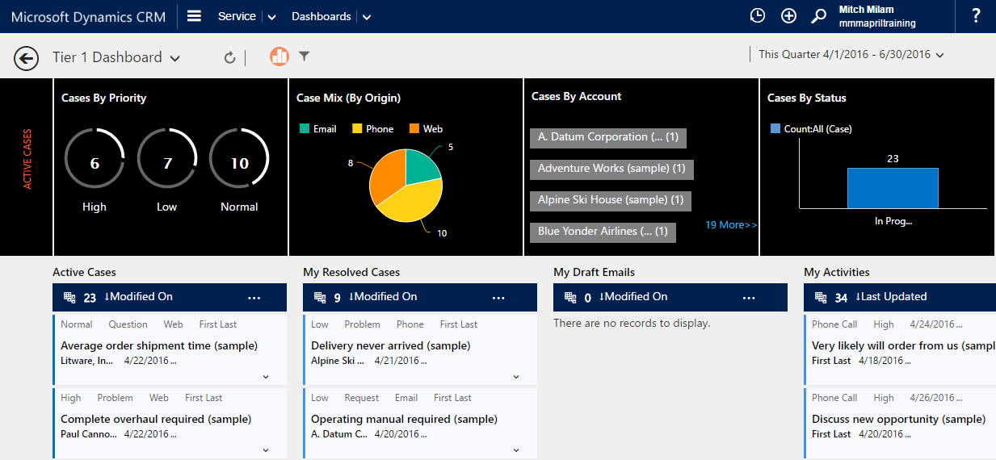
Dashboards

Slide 23
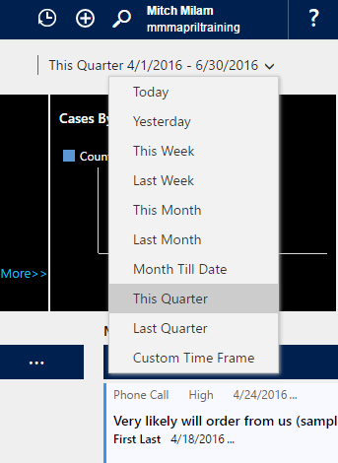
Dashboard Filtering

Slide 24
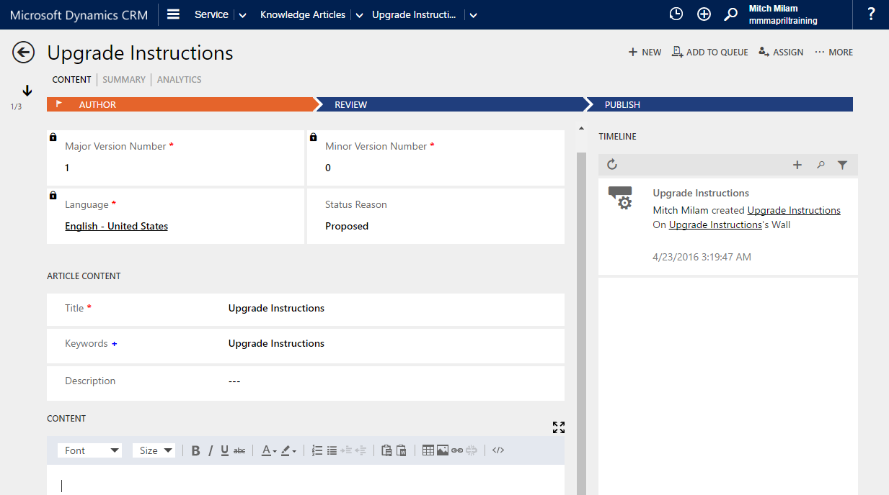
Knowledge Articles

Slide 25
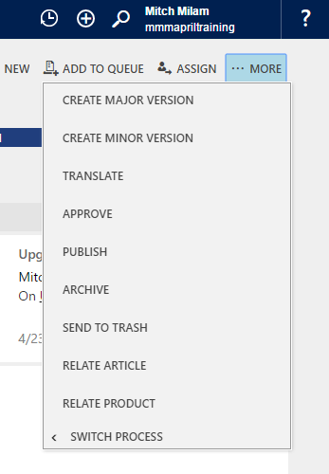
Knowledge Article Actions

Slide 26
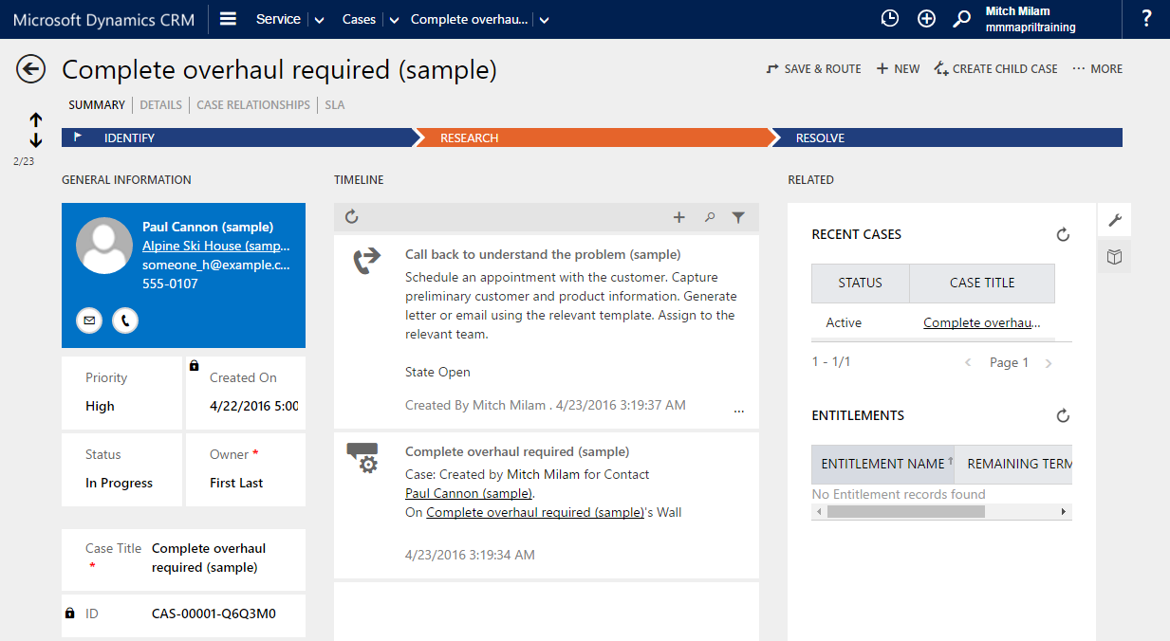
Cases

Slide 27
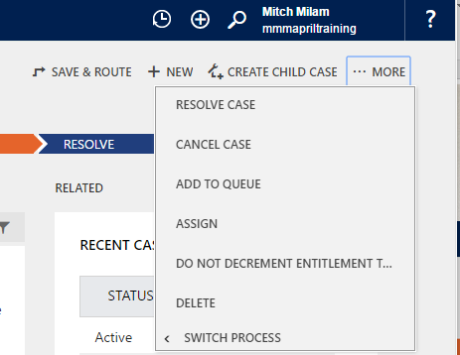
Case Actions

Slide 28
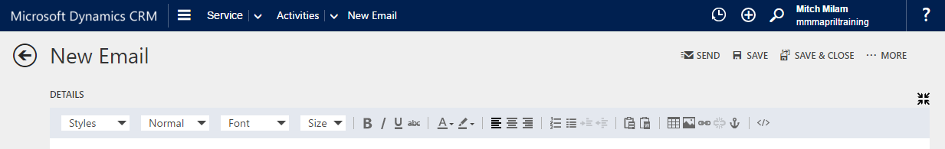
HTML Editor
Email message body
Knowledge Article content

Slide 29
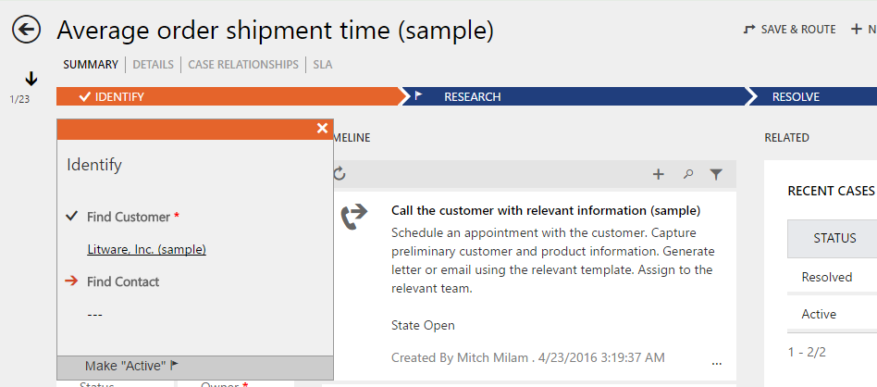
Business Process Flows

Slide 30
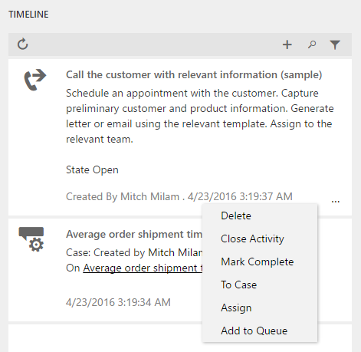
Timeline Quick Actions

Slide 31
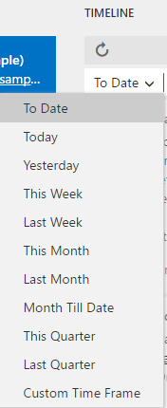
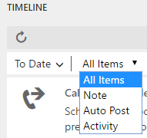
Timeline Filters

Slide 32
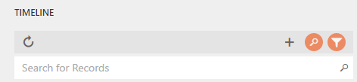
Timeline Search

Slide 33
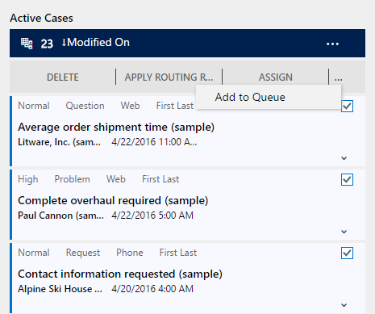
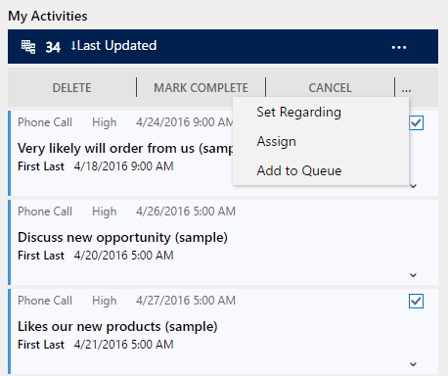
Bulk Actions

Slide 34
Configuration

Slide 35
Default Interactive Entities
Account
Contact
Case
Out-of-the-box activities (phone, task, email, appointment, and social activity)
Social Profile
Queue Item
Knowledge Article

Slide 36
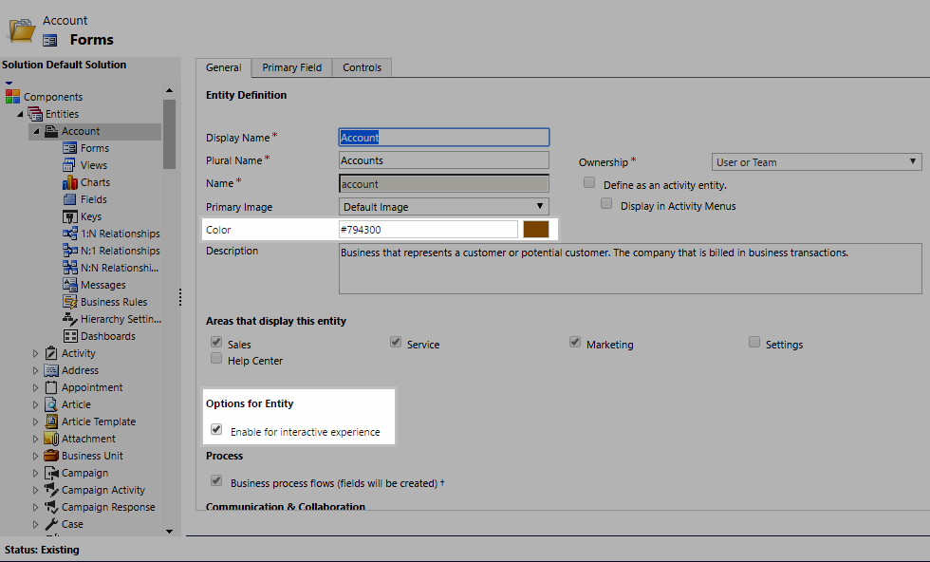
Enable Entity for Interactive Experience

Slide 37
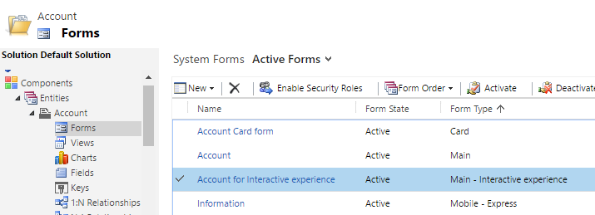
New Interactive Experience Form

Slide 38
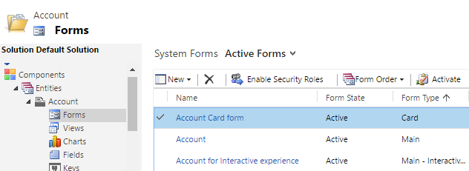
New Card Form

Slide 39
CRM 2016 Update 1
The interactive service hub can now be integrated with Unified Service Desk so users can open and control interactive service hub pages inside Unified Service Desk.
Changes to interactive experience forms:
Add iFrames and web resources
Add the SLA timer to the Main interactive experience form
Made metadata sync improvements to reduce download times for users.
Configure the lookup field properties to show filtered records
Configure language filters in the Knowledge Article Search pane so Customer Service Reps can filter knowledge articles based on languages

Slide 40
Demonstration

Slide 41
Questions?

Slide 42
Thank You

